Slide 1





American Education Research in Education 2016
“Responding to Indigenous Students and their Community’s Voiced Experiences Regarding Effective Teaching Practices”
Tammi Webber, Gail Laffin,
Brian Lewthwaite, Helen Boon.

Slide 2

acknowledgement of country
ACKNOWLEDGEMENT OF COUNTRY
& of Indigenous people present
Notes:
Gail: Acknowledge the land on which we gather on today was, is, and always will be traditional Indigenous peoples land. Furthermore we acknowledge any Indigenous Elders both past, present, and future as they hold the knowledge, the memories, and the wisdom of our peoples across the globe. Intro Tammi & Gail.

Slide 3




What is the focus of the Project?
Mandate for Catholic Education:
to improve equitable outcomes for its Indigenous students
Catholic Education recognises that engaging teachers in inclusive curriculum practices is a central focus in its commitment to provide equitable learning outcomes
To find out the teaching practices that best support Aboriginal and Torres Strait Islander students in their learning
Notes:
Tammi: Acknowledge the Catholic Church’s role in the colonization of Indigenous peoples around the world, & the impact and legacies that continue as part of European assimiliation. Great commitment to Indigenous students. Largest ratio per head for Indigenous students across Australia.

Slide 4
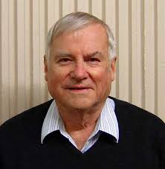
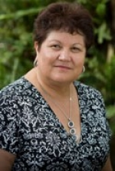
Concerns Across the Tasman
Concern that Hattie’s work is now generalised across all contexts & does not address cultural or social perspectives (decontextualised ‘invisible’) (Snook et al, 2013).
Nationalistic agendas override Indigenous peoples aspirations for education, especially in the important space of teacher-student interaction (McKinley, 2010). The “Closing of the Gap” objectives (2009); New National curriculum with Embedding Indigenous Perspectives as a cross curriculum priority in every subject area; Personalised Learning Plans for ALL Indigenous students.
“There is astoundingly little known about what Aboriginal students see as the qualities of effective teachers and the impact this has on educational outcomes.” (Craven, 2011).
Notes:
Tammi: Lots of qualitative data, no quantitative research. Lots of information from black academics, & from programs the have had great success within Indigenous contexts. However, no one in Australia has ever asked in this context, Indigenous parents & students what we see as makes a good teacher. Providing a ‘voice’ to our mob

Slide 5

Our Research &
Development Work
Phase One (2014): Conversations with students, parents and teachers to identify the teacher actions that influence student engagement & learning
Phase Two (2015): Develop Effective Teaching Profiles used to inform changes in practices
Phase Three (2015-16): Work with teachers of Grade 4, 5 & 6 over the next three years (2014-2016)
Phase Four (2015-2016): Determine influence of these practices on student engagement and learning –
We want to find out what teacher behaviours as voiced by Aboriginal and Torres Strait Islander students and their communities have the most effect on learning
Notes:
Tammi: We are currently between phase 3 & 4

Slide 6
Conversations With Parents
28 parents across 4 schools (Townsville and Mount Isa)
Open-ended conversations
On average, 45 minutes long, and often with an Indigenous teacher or education worker
What are some things that you would like your child’s teachers to know that would help them in their learning?
What can teachers do to help your child or children in their learning?
Notes:
Tammi

Slide 7
General themes
From Parents:
Understanding Our History with education
Understanding the “Code-switching” required of our children
Understanding our perceived Inability to Change Schooling as it exists today
Wanting teachers and schools to hold an Alternative Point of View of Indigenous students and the communities they represent
Wanting schooling and teaching to affirm Cultural Identity
Ensure Learning Priorities are broader than achievement
FOCUSSED MAINLY ON SYSTEMIC ISSUES IN EDUCATION

Slide 8
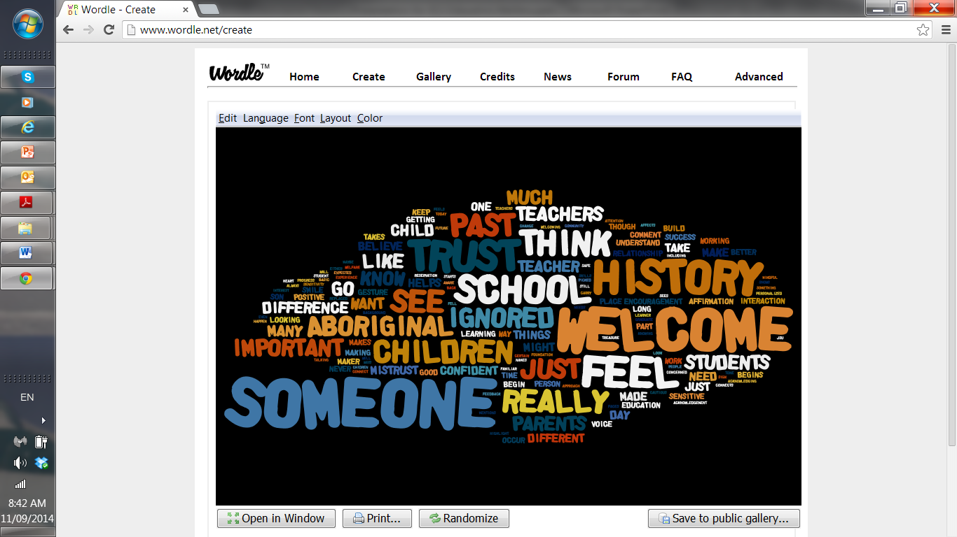
Notes:
Tammi

Slide 9
Conversations with Students
Questions asked:
Next year, you will get a new teacher [for a subject]. What do you want that teacher and classroom to do to help you to learn?
Tell me about classrooms and teachers where you feel good about yourself and learning
Notes:
Gail

Slide 10
General themes from Students:
A classroom climate of ‘warm expectations’
Building cultural bridges as a foundation for respect and learning
Making provision for development of literacy (and numeracy) fluency
There is a tendency towards explicit instruction, emphasising a gradual release of responsibility
Student diversity is accommodated to promote individual engagement and success
A variety of practices support student learning
Being attentive to student health and well being
Developing a classroom environment that supports learning through mainly proactive measures, especially relational
A classroom environment that affirms and welcomes and includes community resources, both physical and human
STUDENTS RESPONSES WERE FOCUSSED ON CLASSROOM PEDAGOGY
Notes:
Gail: best practice worldwide: relationships, understanding the learner, scaffolding, modification & differentiation, creative & resourceful.

Slide 11
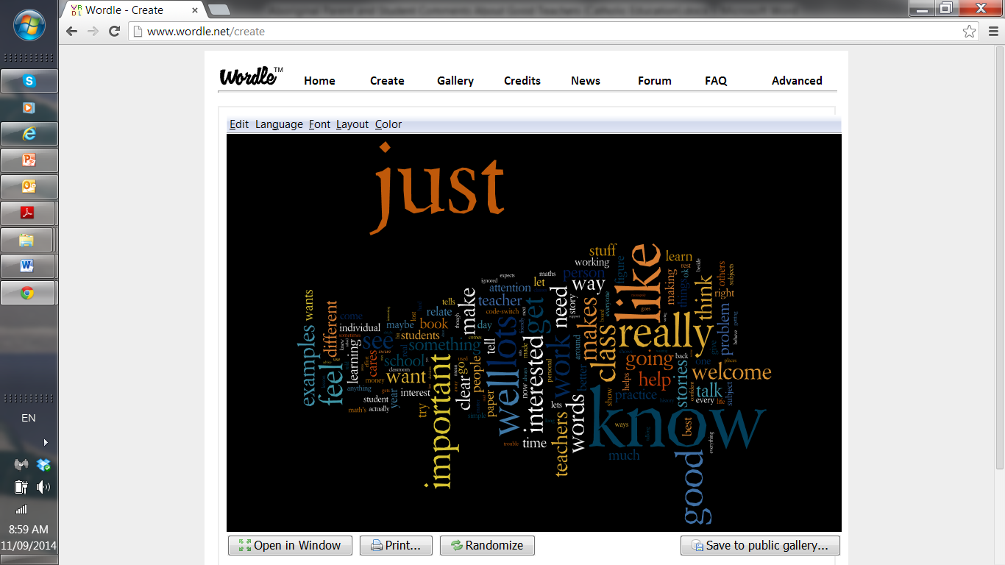
Notes:
Gail

Slide 12
General themes from Teachers:
Essential classroom skills as being ‘well developed & diverse teaching skills.’
Individual accommodation: differentiate instruction to address variability in student capabilities.
Developing students’ holistic needs not just academically but socially, spiritually, and occasionally culturally.
Identified affective relationships, are a critical component to building positive relationships and affirming students in their learning.
Students adjustments and code switching in negotiating the demands of schools, particularly in reference to English language.
Emphasis on explicit teaching with learning goals, demonstrations, focus on learning processes, gradual release of responsibility, and scaffolded inquiry.
Importance of creating a supportive environment.
Importance of relevant learning, not abstract concepts.
Teachers verbalized an ethic of care, but not an ethic of practice.
Notes:
Gail: 60 teachers across the 4 schools completed the CRP on-line questionnaire (60 items)

Slide 13
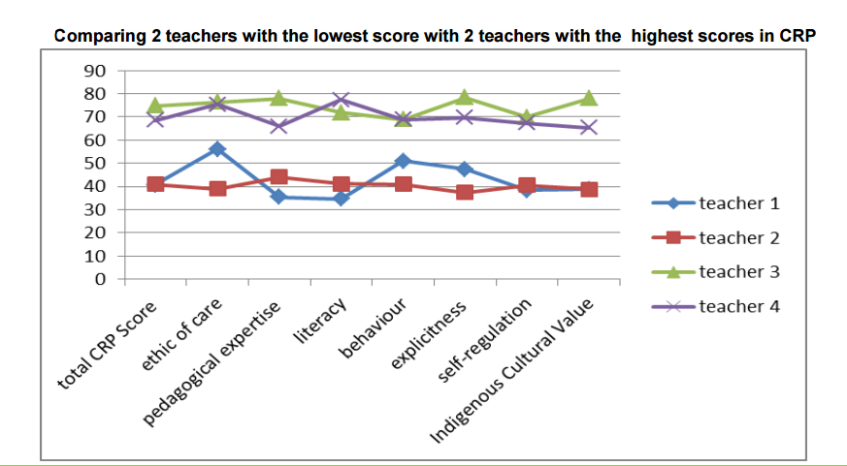
Comparing 3 teachers with identical overall score on CRP
2 highest & lowest teacher results, identified change in secondary
Notes:
Tammi

Slide 14
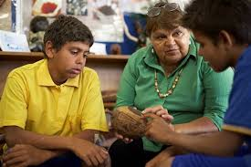

Parents
Teachers
Affective Relationships
Code switching
Students
Notes:
Tammi

Slide 15
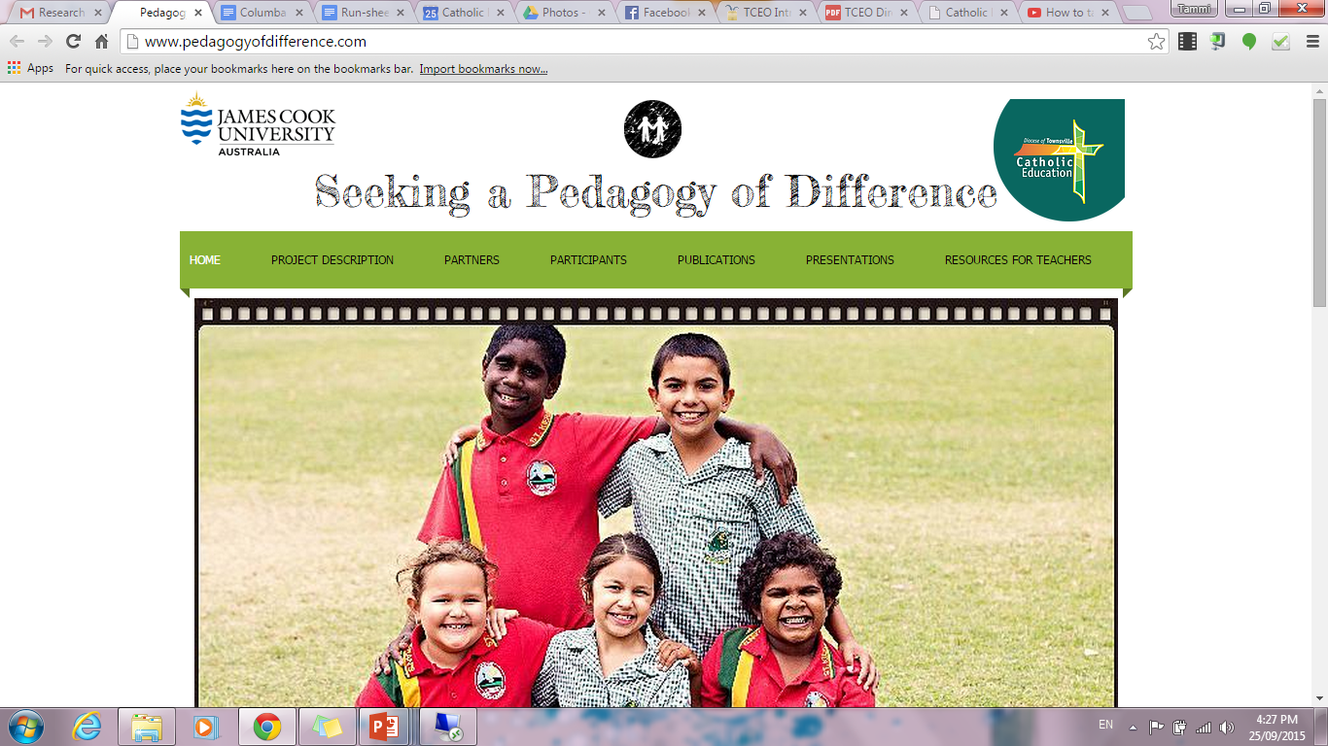
Further Information available on website:
www.pedagogyofchange.com
Notes:
Tammi: website for further information, findings, & journals. In the next month an online assessment tool as a survey for teachers to measure their CRP. Future proposals: Secondary research, & support tools/resources for teachers.

Slide 16
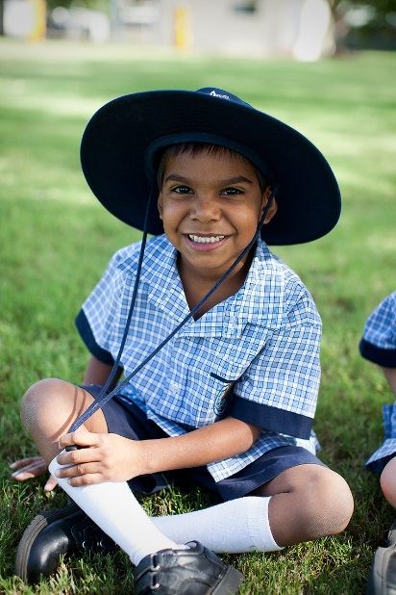

The future of our nation rests on the quality of our teachers, and their willingness and ability to make a real difference.
Craven, R. (2011:21)
Thank you for listening
Notes:
Tammi.

